Slide 1
TEAM NAME:CANVAS CREW PRODUCT:WHOLESOME

Slide 2
Problem Statement
Many individuals consume meals without understanding their nutritional composition such as calorie intake and food balance.
Existing nutrition tracking applications are often complex, paid, or designed for advanced users. They frequently require extensive manual input, subscriptions, or professional knowledge, which discourages students and beginners from using them effectively.
There is a clear need for a simple, beginner friendly, and accessible nutrition analysis tool that helps users gain basic awareness of their daily food intake without medical or professional complexity.

Slide 3
Product/ Solution - Innovation
Wholesome Nutrition AI is a web based nutrition analysis application that allows users to build meals from commonly consumed food items and view basic nutritional insights.
The application focuses on simplicity and ease of use by providing:
A clean meal builder interface
Rule based nutrition analysis using predefined data
Daily meal logging for awareness and tracking
The solution is designed as a Minimum Viable Product that demonstrates how cloud based platforms can be used to build scalable and user friendly health awareness tools.

Slide 4
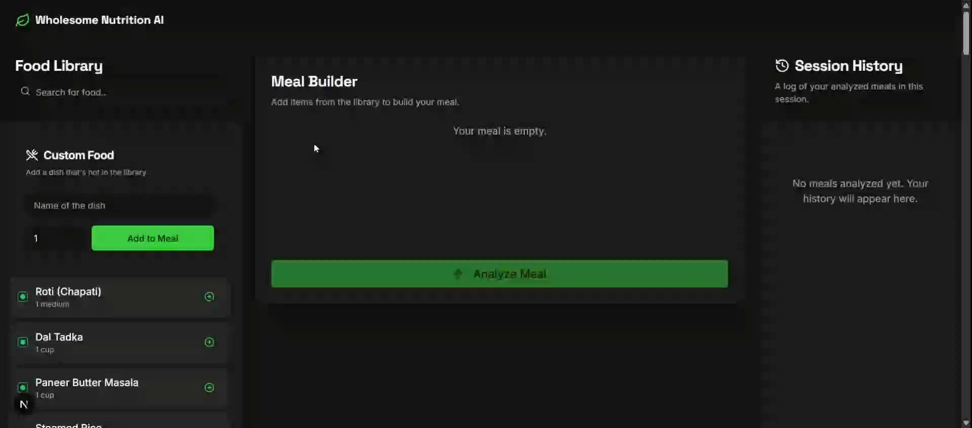
Watch our demo to see WHOLESOME in action

Slide 5
Key Features (MVP)
The current MVP of Wholesome Nutrition AI includes the following features:
Selection of food items from a predefined food database
Custom food entry for flexibility
Meal builder to combine multiple food items
Nutrition analysis using predefined calorie values
Daily meal log with total calorie calculation
Session based history storage using cloud database
These features directly reflect the functionality of the deployed application.

Slide 6
Technology Stack
Frontend
HTML
CSS
JavaScript
Backend and Platform
Firebase Studio
Firebase Firestore
Firebase Hosting
Design Tools
Figma for UI and wireframe design
This technology stack supports rapid development, scalability, and ease of deployment for an academic MVP.

Slide 7
Market Perspective
There is increasing awareness around health and nutrition, especially among students and young professionals.
While existing nutrition applications exist, many are complex or subscription based. Wholesome Nutrition AI positions itself as a simple, accessible alternative focused on awareness rather than advanced medical guidance.
The project demonstrates potential for future expansion while currently serving as a functional and educational MVP.

Slide 8
Business Model & Strategy
Wholesome Nutrition AI is currently developed as an academic Minimum Viable Product. Initial growth is expected through classroom use, peer adoption, and academic demonstrations. User growth in the early phase is focused on validating usability rather than monetization. As features mature, the application can support a larger user base due to its cloud based architecture. Future adoption may include students, fitness beginners, and health aware users. Any monetization strategy would be explored only after feature validation and user feedback. Revenue estimation is intentionally excluded at this stage to maintain academic focus. The project demonstrates scalability potential rather than immediate commercial outcomes.

Slide 9
Product Milestones
First Milestone
Design and development of the Minimum Viable Product focused on nutrition awareness. This includes building the web based user interface, implementing food selection and custom food entry, developing the meal builder, and enabling rule based nutrition analysis using predefined data.
Conduct functional testing to validate usability, correctness of nutrition calculations, and smooth user interaction within the application.
Second Milestone Integration of session based meal history using cloud database services and deployment of the application using Firebase Hosting.
Preparation of complete project documentation, including Product Requirements Specification, Design and Architecture documentation, Test Plan, User Guide, and Sprint Plan.
Delivery of a final working product demonstration along with a professional pitch presentation for academic evaluation.

Slide 10
Total Budget, Required Support and Regulation
The project is developed as an academic Minimum Viable Product using cloud based tools. The overall development cost is minimal due to the use of Firebase Studio and open web technologies. Expenses are primarily related to development effort, testing, and documentation. Cloud services such as Firebase Hosting and Firestore are used within free or academic usage limits. No specialized hardware or paid infrastructure is required. The application does not collect sensitive personal or medical data. Basic data privacy principles are followed for all stored information. The current MVP provides a foundation for future enhancements if extended.

